Slide 1
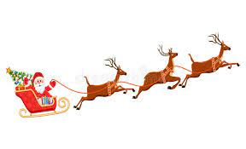
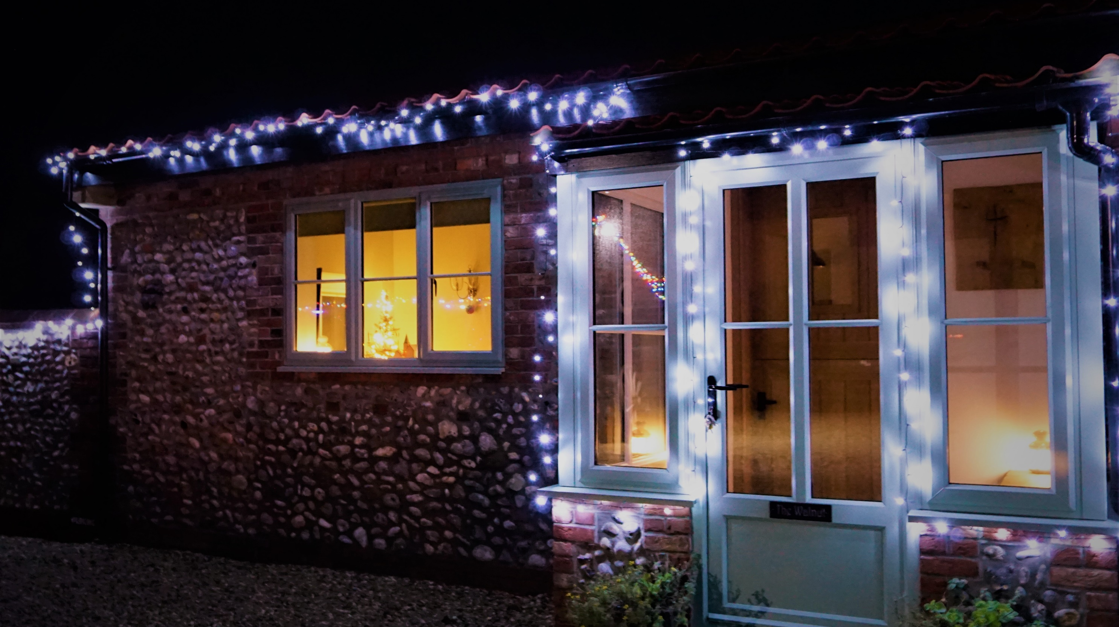
A warm, cosy and welcoming Walnut, bracing walks along deserted beaches,
a Christmas Hamper bursting with delicious local goodies…………
what more could you ask for?
A hot tub maybe?
We’ve got one of those too!
Escape to The Walnut
for a magical
Norfolk Christmas…..

